Slide 1
The news isn’t missing. It’s buried.
Nadella says AI models need an ‘emergency brake’ · Odyssey-3 is a new generative world model
ArXiv caps submissions at two per month as AI paper flood overwhelms the preprint server
ONE ORDINARY MORNING OF AI NEWS
Cheaper AI tokens are driving more demand · Mac users are nuking every trace of Apple AI
AI agents overstate their results, study finds · Netflix has used AI on about 300 titles
Nvidia in talks to acquire Reflection AI · I made terrible games with Google’s AI Playground
Voice AI hasn’t reached its ChatGPT moment yet · Build your own decision model
DistroKid has been quietly taking down songs · Anthropic is banishing its model evals from the internet
AI is creating a ‘human premium’ for art · Learning to use local AI is exciting and overwhelming
Letting AI agents decompile a first-person shooter · New controls in Copilot for JetBrains
AI data centers not paying their costs · A pay gap between male and female AI agents
Apple hires team from personalized podcast startup · Impactful scheduling for GPU clusters
My AI agent posted my bank details on company Slack · Treating bugs like patients
Anthropic asks users to stop being mean to Claude · AI-native studios can create original IP
[TEAM NAME] · [EVENT NAME]
This graph of data center spending will give you chills · Python 3.15.0 added to actions
Major publishers reportedly cover their books in AI slop · Joseph Gordon-Levitt on AI
Notes:
Do not introduce the project yet. Let the wall sit for a few seconds: every line behind the title is a real headline our system collected on one ordinary morning. Then say it: the news isn't missing, it's buried. The problem is not that we lack information. It is that finding the part worth our attention takes work. About 40 seconds.

Slide 2

News is how we see change coming.
WHY NEWS MATTERS
Build.
Learn.
Decide.
Know what just became possible.
Know which skills are next.
Act on today, not last month.
AIDEA
02
Notes:
Why does this matter? News is how we see change before it reaches us. It tells a developer what just became possible to build, a student which skills come next, and anyone leading a team what to decide. In a fast field, a few weeks behind means working from an old map. So the question is not whether to follow the news. It is what following it costs. About 45 seconds.

Slide 3
And it lives in 41 places.
THE FRAGMENTED REALITY
Anthropic
The Verge AI
Hugging Face
Hacker News
GitHub Changelog
TechCrunch AI
Google AI
FTC
Variety
The Decoder
Wired AI
Latent Space
European Commission
BBC Technology
DeepSeek
Ollama
The Guardian AI
404 Media
Futurism AI
Tech Policy Press
AIDEA · 20 of the 41 sources our system follows
03
Notes:
Here is the first difficulty. The stories are not in one place. A research result appears on one site, a product launch on a company blog, a policy change on a government page, and the reaction on a forum. These are twenty of the forty-one sources our own system follows, and they are all real. Company blogs, press, newsletters, regulators, developer changelogs. Nobody opens all of these every morning. So most of us follow three or four and hope the rest reaches us somehow. About 50 seconds.

Slide 4
Keeping up costs more than time.
THE HIDDEN COST
Time
Attention
Misses
Habit
Effort
Searching and screening.
Every tab is a context switch.
The big story, under ten small ones.
First thing dropped on a busy day.
You still decide what matters.
AIDEA
04
Notes:
What does that scattered landscape cost? Five things. Time, for the searching and screening. Attention, because every source is a switch of context. Misses, because the story that mattered sits under ten that did not. Habit, because a tedious routine is the first thing dropped on a busy day. And effort, because after all that you still have to decide what matters. We will put a number on the first one next. About 50 seconds.

Slide 5
Seven steps. Every day.
THE DAILY LOOP
1
2
3
4
5
6
7
Open
Scan
Click
Judge
Compare
Save
Repeat
22,735
73
6.5 hrs
entries to scan
stories worth it
to read them
AIDEA · measured over our first five days of runs
05
Notes:
This is the routine. Open the sources, scan the headlines, click the likely ones, judge whether each is real, compare the coverage, save what is useful. Then repeat tomorrow. Now our own numbers, measured by the system over its first five days. Its sources carried 22,735 feed entries. 73 stories were worth telling. Reading the articles behind those 73 would take about six and a half hours at a normal reading speed, and that is before the time spent finding them. About 60 seconds.

Slide 6
We start where it’s loudest.
WHY AI NEWS FIRST
Models
Products
Agents
and research
and launches
and developer tools
Deals
Policy
Real use
and investment
and safety
in the world
AIDEA · six kinds of story, moving every day
06
Notes:
We had to pick one field to start with, and we picked AI on purpose. Following AI means following six kinds of story at once: models and research, products, agents and developer tools, deals, policy and safety, and real-world use. They come from research sites, company blogs, the press, regulators and forums, and they change daily. Be clear about the claim: we start with AI not because the problem is limited to AI, but because AI moves fast enough that the problem is impossible to miss. About 50 seconds.

Slide 7

Access is solved. Attention isn’t.
THE INSIGHT
So we built a better way to find what matters.
AIDEA
07
Notes:
This is the turn in the story, so slow down and let the red slide land. Access is solved: anyone with a phone can reach every one of those sources for free. Attention is not: nobody has the hours to find the part that matters. That changes what is worth building. The world does not need another source of AI news. It needs a better way to find, filter and deliver what is already out there. About 35 seconds.

Slide 8
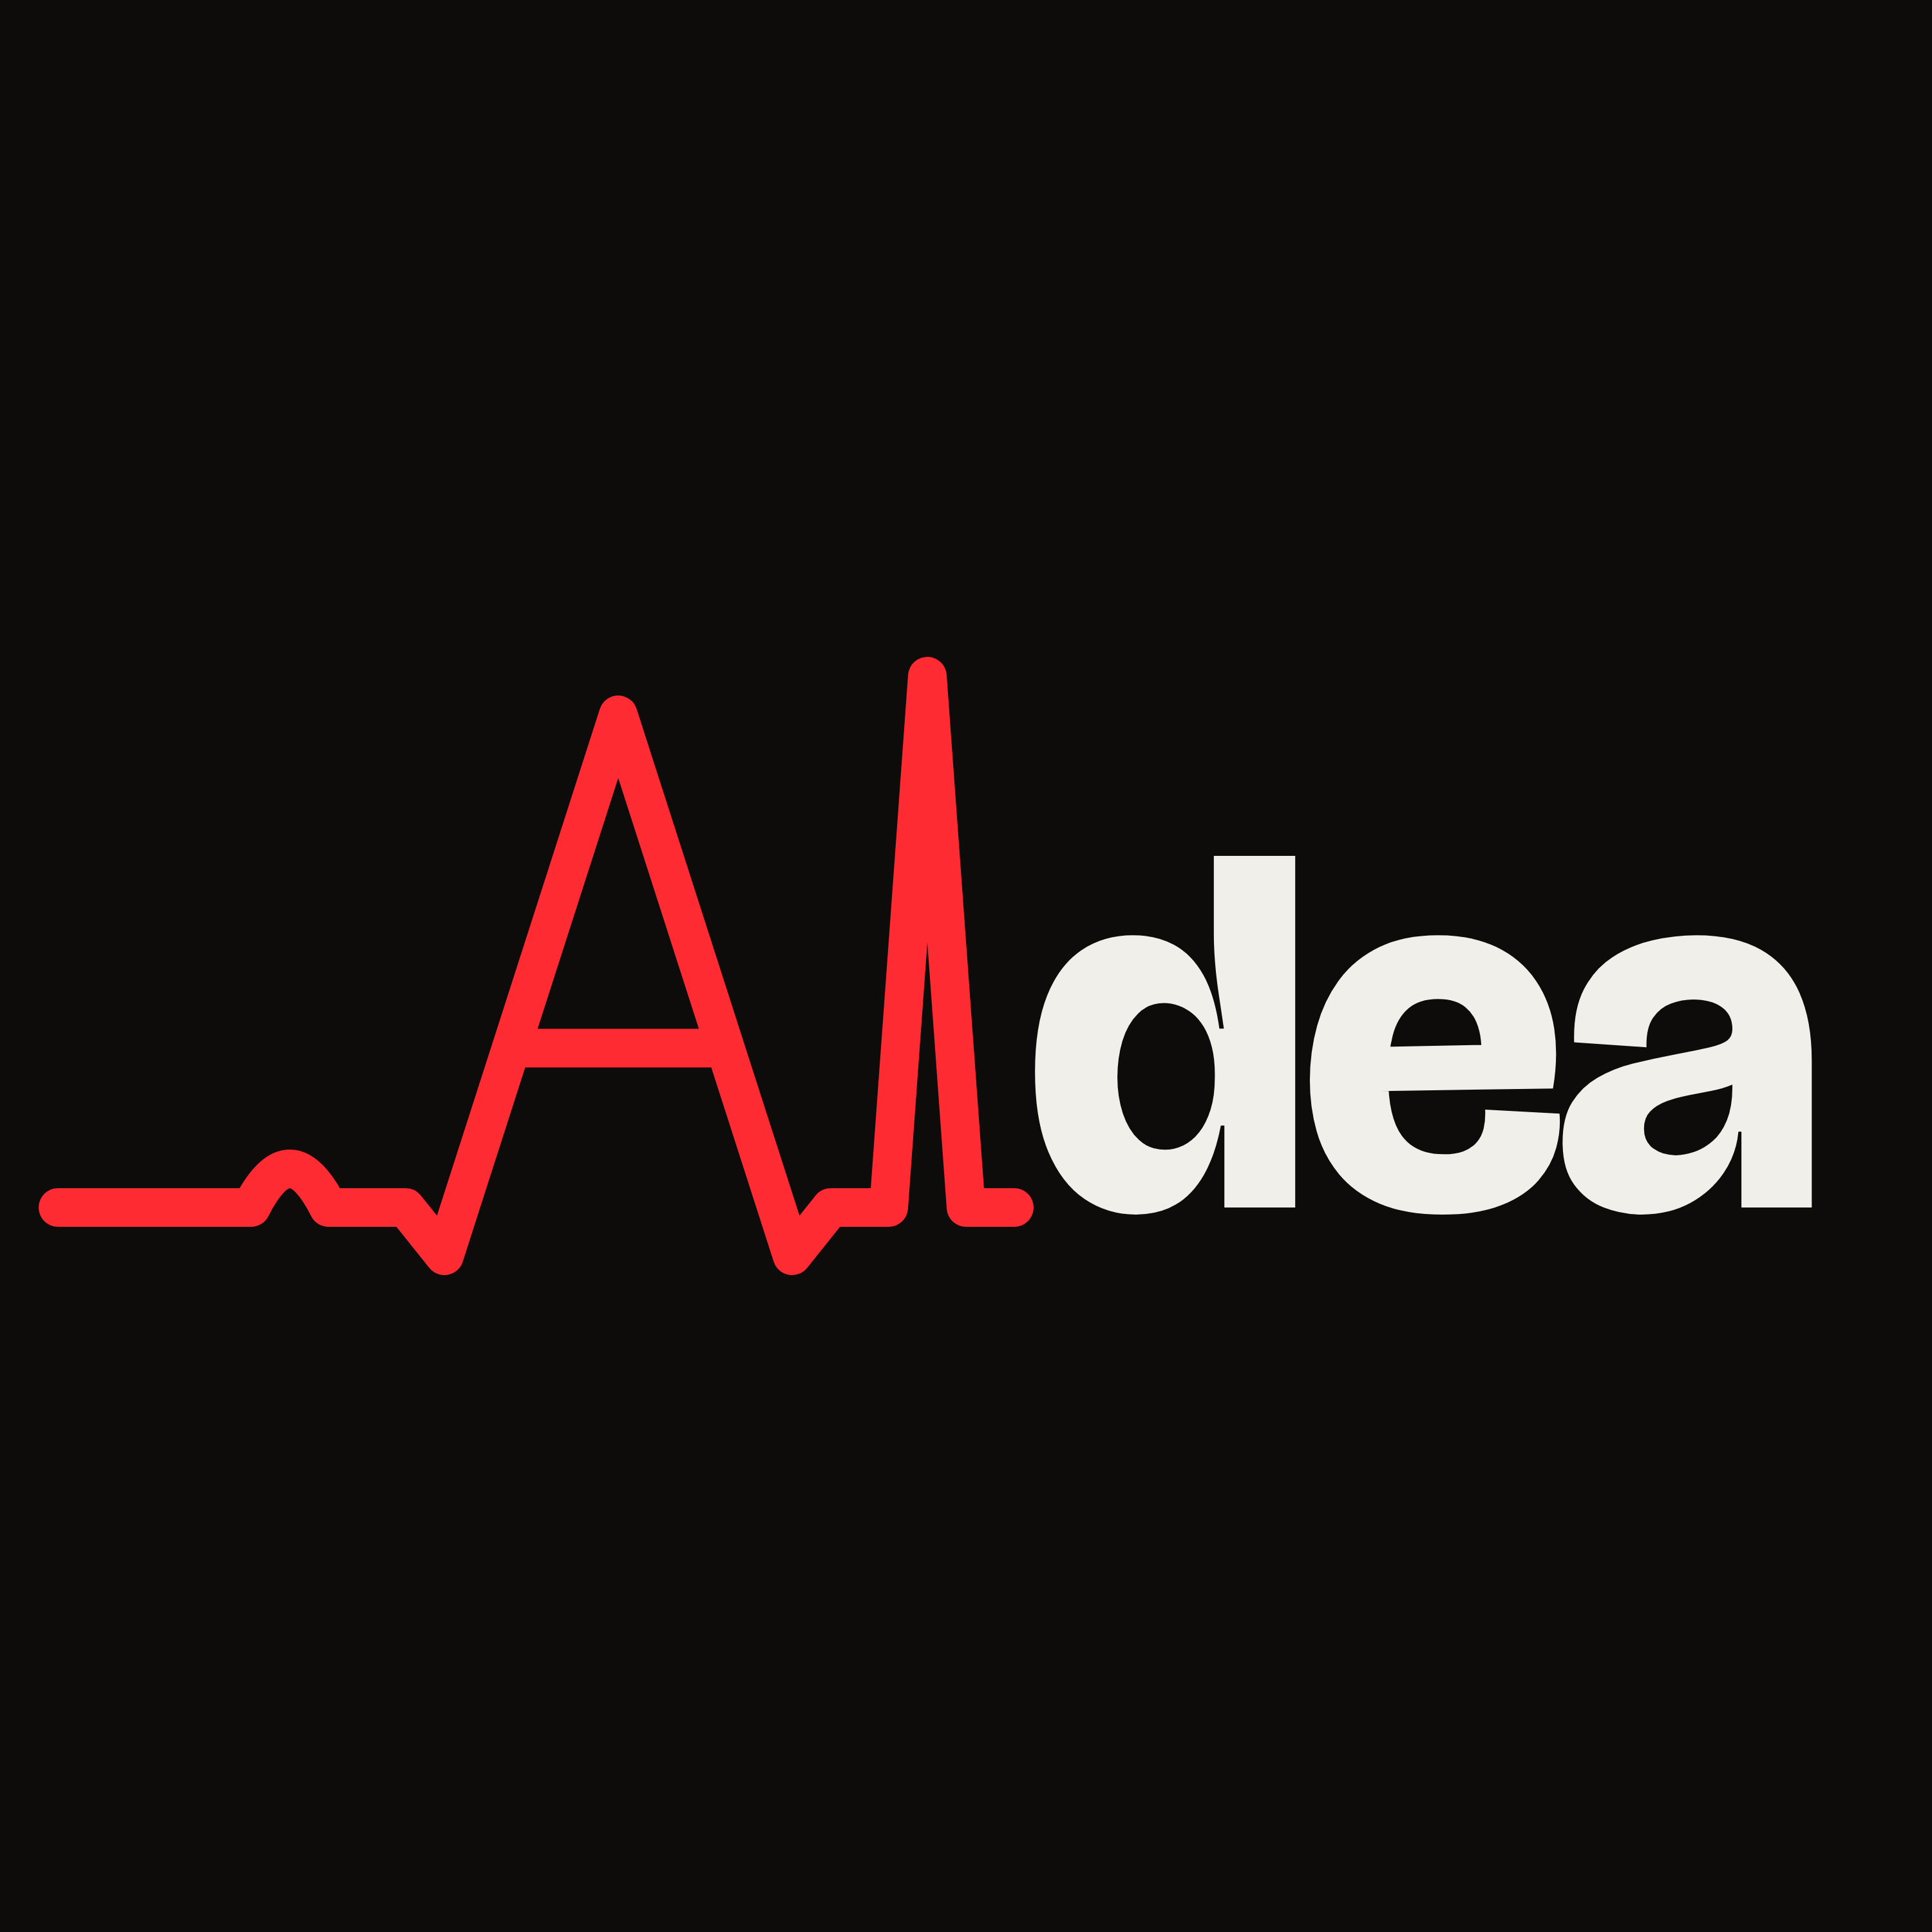
AI news. Fresh perspectives.
MEET AIDEA
The day’s AI news. Found, filtered and read to you.
Notes:
Now the name. This is AIdea. AI news, fresh perspectives. In one line: the day's AI news, found, filtered and read to you, with every story linked back to its sources. The logo is a signal line that spells A and I: one clear signal pulled out of the noise. About 35 seconds.

Slide 9

Hear it. Read it. Check it.
THE EXPERIENCE
FROM A REAL EDITION
Odyssey has opened a free public research preview of its interactive world model, Odyssey-3.
[Play 20 seconds of a real episode]
ArXiv will limit each person to two submissions per calendar month, citing a surge in AI-driven papers.
5
73
98
Reported · sources linked
editions
stories
minutes
AIDEA
09
Notes:
Here is what a listener gets. On the left is real output: two headlines from one of our editions, word for word, each labelled for how well sourced it is and linked to its articles. On the right, play about twenty seconds of a real episode; add that clip before presenting. So far: five daily editions, 73 stories, 98 minutes of audio. Every edition comes three ways: audio to hear, a newsletter to read, and show notes to check. About 80 seconds with the clip.

Slide 10
A pipeline, not a prompt.
UNDER THE HOOD
SOURCES
COLLECT
FILTER
GROUP
RANK
WRITE
SPEAK
41
22,735
416
315
73
12,306
98 min
followed
entries
about AI
stories
chosen
words, checked
of audio
Red uses the language model. The rest is plain code. Python · SQLite · Claude Sonnet 5.5 · Chatterbox Turbo
AIDEA · totals over our first five days of runs
10
Notes:
This is the architecture, and the number under each stage is what has actually flowed through it in five days. Left to right: 41 sources followed. 22,735 entries collected. A filter kept 416 that were recent and about AI. Grouping merged duplicates into 315 stories. An editor model ranked them and chose 73. The writer produced 12,306 words, every sentence checked against its sources. And it was spoken as 98 minutes of audio. The point for the judges: this is a twelve-step pipeline, and the language model is used in only the three red stages. The rest is plain code that behaves the same way every time. Python runs it, SQLite stores every decision, Claude Sonnet 5.5 edits and writes, and Chatterbox Turbo speaks on our own graphics card. About 90 seconds.

Slide 11
Built to check itself.
TRUST
243
17
3
397
automated tests
unsupported lines caught
confidence labels
decisions logged
AIDEA · written from sources only, approved by a person
11
Notes:
A news product is only useful if you can trust it, so quality is built in. Four measured numbers. 243 automated tests guard the pipeline's rules. Across the editions so far, the source check caught 17 lines that contained a name or number the sources did not support, and removed them before they were spoken. Every story carries one of three confidence labels: confirmed, reported or rumour. And all 397 requests to the language model are logged, so any decision can be traced. The script is written only from the source articles, a failing source never stops a run, and a person approves each edition. Next we will measure stories missed, against a hand-marked set. About 70 seconds.

Slide 12
THE DIFFERENCE
6.5 hours of reading.
98 minutes of listening.
Same five days. Same 73 stories.
AIDEA · our own figures, reading at 230 words a minute
12
Notes:
The second red slide, and the payoff. Over the same five days and the same 73 stories: six and a half hours of reading, or 98 minutes of listening. That is about a quarter of the time, and none of the searching, because every story has already been grouped with its duplicates, ranked against the others and linked to its sources. We will keep measuring three things as it grows: time to a useful briefing, stories found and missed, and lines that fail the source check. About 45 seconds.

Slide 13
Now. Next. Later.
ROADMAP
NOW
NEXT
LATER
Daily AI briefing
41 sources
Source-checked script
Audio and newsletter
Spotify and Amazon Music
A host and a guest
More sources
A scored quality set
Personal briefings
Fields beyond AI
AIDEA
13
Notes:
Three columns, and we are careful about which is which. Now: everything in the first column exists and runs today. A daily AI briefing from 41 sources, a script checked against its sources, and audio plus a newsletter as output. Next: publishing on Spotify and Amazon Music, a host-and-guest conversation format we have already prototyped, more sources, and a hand-marked set to score quality. Later, once the AI use case is proven: briefings personalised to each listener, and the same pipeline pointed at other fast-moving fields. About 50 seconds.

Slide 14
Less noise. More signal.
Less time finding it. More time understanding what matters.
[TEAM NAME] · [CONTACT OR LINK]
Notes:
Come back to where you started. The world does not need people to spend more time searching for information. It needs better ways to find the information worth their attention. Then the closing line, slowly: AIdea. Less noise, more signal. Less time finding it, more time understanding what matters. Thank the judges and leave this slide up for questions. About 30 seconds.

